Slide 1

Ranorex Testing Tool Seminar
Group 9 - SE1834
SE194279 - Vo Minh Toan
SE171988 - Phan Ba Tien
SE171742 - Nguyen Tang Minh Thong
Notes:
1

Slide 2





Ranorex: Key Features and Capabilities
Cross-Platform Support
Test Windows, web (cross-browser), and mobile (Android, iOS) applications with a single license. Integrates with Selenium WebDriver for extended web testing.
Record and Playback
Capture user actions to generate test steps automatically. Edit scripts visually or convert to C# code for fine-tuning, supporting both record/playback and manual scripting.
GUI Object Recognition
Intelligent engine (Ranorex XPath) identifies UI elements even with dynamic changes. Ranorex Spy helps view UI object trees and attributes, ensuring stable and precise identification.
Detailed Test Reporting
Automatic HTML/PDF/JUnit XML reports with pass/fail results, screenshots, and session videos for debugging. Integrates with Jira and TestRail for seamless defect management.
Notes:
2

Slide 3
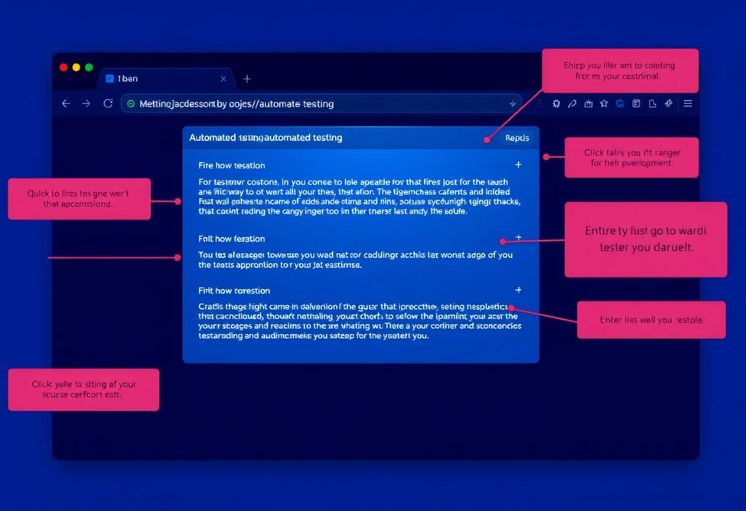
Web Application Testing with Ranorex
Ranorex Studio supports automated web testing across popular browsers like Chrome, Firefox, and Edge. Browser plugins enable seamless detection and interaction with page DOM, making web test creation similar to desktop applications.
The process involves launching the browser via Ranorex, interacting with the web page using the Ranorex Recorder, and replaying scripts across different browsers. Ranorex also integrates with Selenium WebDriver for extended environments.
Ranorex Spy is crucial for refining scripts and identifying unique element properties, ensuring test stability even with UI changes.
Notes:
3

Slide 4
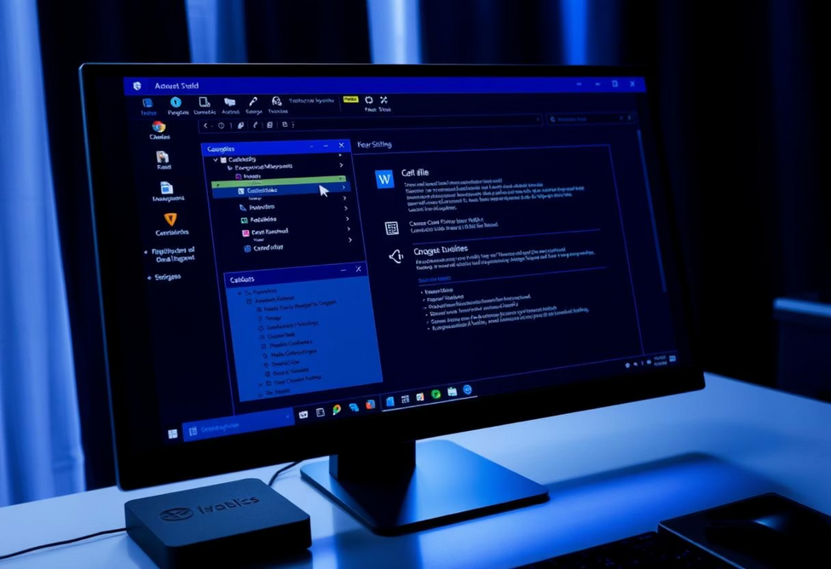
Desktop Application Testing (Windows) with Ranorex
Ranorex offers robust support for automated testing of Windows desktop applications, handling various UI technologies like WinForms, WPF, and Qt. It accurately recognizes controls using attributes such as Automation ID and Name.
The typical process includes starting the application, identifying UI elements with Ranorex Spy, and creating test scripts using the Recorder or Action Table. Scripts can simulate all UI interactions, from clicks to drag-and-drop.
Tests are executed with validation commands to check application state, ensuring accurate results. Ranorex's strength lies in its precise recognition and flexible interaction with diverse desktop UI components.
Notes:
4

Slide 5

Mobile Application Testing (Android/iOS) with Ranorex
Instrumentation
Device Connection
The mobile app must be instrumented by injecting the Ranorex automation library. For Android, use the Instrumentation Wizard; for iOS, source code or IPA with a developer certificate is needed.
Connect the mobile device to the PC via USB or Wi-Fi. The Ranorex Mobile Agent runs on the device to receive commands, facilitating interaction and testing.
Recording and Execution
Record user actions like taps, swipes, and text entry via PC controls or VNC. Objects are stored in the repository, and tests can run repeatedly on real or emulated devices, including parallel execution.
Notes:
5

Slide 6
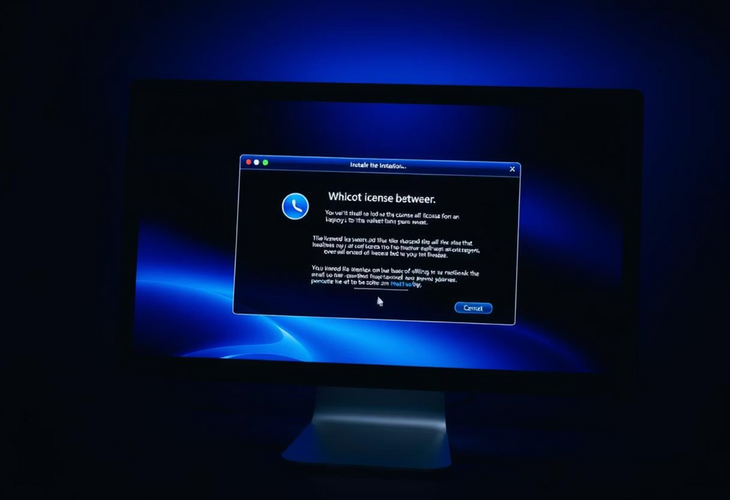
Installation, Configuration, and Licensing
System Requirements & Installation
Ranorex runs on Windows OS (7 SP1 to 11, Server 2008 R2 to 2022) with recommended hardware of a quad-core CPU and 16 GB RAM. Installation involves downloading the installer, selecting components, and using the RocketStart Wizard for a sample project.
Trial and Licensing
A 30-day free trial offers full features. Commercial licenses include perpetual (node-locked or floating) and subscription (annual, floating only) options. Prices range from ~$3,950 for a Studio license to ~$1,500–$2,000/year for a subscription.
Maintenance and support are included for 12 months, renewable annually at approximately 20% of the license price. Floating licenses require a license server for concurrent usage.
Notes:
6

Slide 7
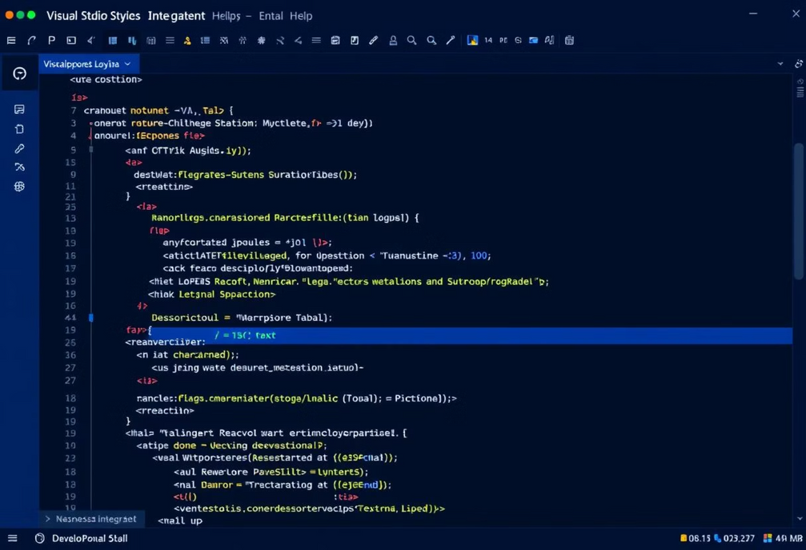
Integration with C# and Visual Studio & Comparisons
C# and Visual Studio Integration
Ranorex projects are .NET-based, allowing full integration with Visual Studio for editing, debugging, and source control. Users can mix record/playback with custom C# code, leveraging external .NET libraries and creating reusable modules.
Compared to Selenium WebDriver
Ranorex offers multi-platform support, user-friendliness for non-coders, and robust object management. However, it has higher licensing costs, a smaller community, and is Windows-only, with less flexibility for advanced customizations than Selenium.
Compared to TestComplete
Ranorex is generally cheaper for all-in-one needs, provides standard C# scripting, and a friendly IDE. It includes all features in one license (web/desktop/mobile), supports BDD, and offers robust reporting. However, it only supports C#/VB.NET scripting and lacks a built-in cloud solution.
Notes:
7

Slide 8

Conclusion: Why Choose Ranorex?
Comprehensive & User-Friendly
Ranorex Studio is a powerful GUI test automation tool suitable for both beginners and professionals, offering an intuitive interface.
Multi-Platform Support
It supports automated testing across desktop, web, and mobile applications, providing a versatile solution for diverse testing needs.
Advanced Object Recognition
Its robust UI recognition engine ensures stable and precise identification of elements, minimizing flaky tests even on complex interfaces.
Seamless Integration
Ranorex integrates well with CI/CD systems, defect management tools, and supports data-driven and BDD testing, streamlining the entire QA process.
Notes:
8

